Slide 1
Stage II (“Investment Thesis to Investment Committee”) Project Tetris Proposed Investment of up to USD40m into Databricks Inc. (“Databricks”), an advanced big data processing company 19 October 2018

Slide 2
1. Executive Summary (1/1)
Project Overview
Objective: To determine if there is a statistically significant relationship between a company’s EV/TTM Revenue multiple and their other defining characteristics and whether that relationship can be used for predictive purposes.
Scope: The project’s analysis and predictive parameters are limited to late-stage, high-growth technology companies.
Result: There appears to be statistically significant relationships between a company’s characteristics and their valuation that can be used as a predictive model. However, the results are not reliable for private companies and still subject to discretion as the methodology is developed further (see pg. 5).
Screening Universes
Screening Variables
A
Databricks Main Comps – 19 companies originally identified for studying and comparison for Project Tetris.
Dependent Variable | EV/TTM Revenue Multiple
Independent Variables | NTM Revenue Growth Rate (%) TTM Gross Margin (%) TTM R&D % of Revenue (%) TTM S&M % of Revenue (%) TTM EBITDA Margin (%) TTM Profit Margin (%)
B
Bessemer Emerging Cloud Index – 46 emerging public companies primarily involved in providing cloud software and services to their customers.
C
Public Software Companies – 120 publicly listed companies¹ with a market cap <USD20bn and >USD200mn.
Methodology
Summary of Findings
Data Preparation: The dataset was condensed from 185 total companies across universes A, B, C to 121 after removal of duplicates and companies with incomplete data.
Model Preparation: Three regression models were set up for the testing, a simple linear regression model and a “boosted” machine learning regression model (Adaptive Boost Regression).
Data Organization: The 121 companies were randomly split into a training population (~70%, 84 samples) and a testing population (~30%, 37 samples). The training population was used for training the regression models, the testing population was used to test the accuracy of the models’ predictions.
Variable Testing: The independent variables were tested in 7 different combinations to determine the most statistically significant grouping related to the dependent variable.
Testing and Comparison: Both models were tested against the testing population to determine their accuracy.
Visualization and Application: Both models were graphed and plotted against each other and the actual data as well as used to predict Databricks’ multiple.
1
There appears to be a statistically significant relationship between a company’s EV/TTM Revenue multiple, their Gross Margin, their EBITDA Margin, their Profit Margin, and their Revenue Growth Rate.
The line of best fit produced by the linear regression model could predict 51% of the testing population (vs. 66% for the boosted model). When applied to the entire population, the linear model could predict 43% of the total values while the boosted model could predict 76%. *Predict is used as a high level, not entirely accurate term here, explained further in paper.
2
3
While both models performed reasonably well
Note: (1) Listed in North America, Subsectors “Application Software” + “Data Processing” + “Systems Software”
Source: Bloomberg

Slide 3
PROJECT TETRIS: Proposed Investment of up to USD40m into Databricks, an advanced big data processing company
Investment Committee Paper No: [ ]
Division: INVESTMENTS
Priority: HIGH
FOR APPROVAL
2. Variable Testing
A correlation test was first performed to determine the correlation between each independent variable and the EV/TTM Revenue multiple. A preliminary linear regression was then conducted to determine significant variables according to p-values (<0.05).
Significance Testing
Scenario Testing
1
Statistically significant variables were determined to be revenue growth, gross margin, and EBITDA margin. “Significant” was determined to represent an independent variable with p-value < 0.05 in a scenario where all variance inflation factors (“VIF”) remained below 5. More details and methodology in Appendix ##.
1
Further stepwise regression was applied to all scenarios and variable combinations that include the three significant variables. The linear regression model was applied once to each scenario while the adaptive boosted regression model was applied 100 times to each scenario, with the case that performed optimally the most amount of times selected.
The entire population was then divided into a training population (~70%, 84 samples) and a testing population (~30%, 37 samples). This meant that the model would be give a “fresh” data source, the testing population, when evaluating for its performance and predictive capabilities.
The results of the test are consistent with the original
2
2
Scenario | Revenue Growth | Gross Margin | EBITDA Margin | R&D % of Rev | S&M % of Rev | Profit Margin | Linear Adjusted R² | Boosted Adjusted R²
0 (Base) | ✓ | ✓ | ✓ | ✓ | ✓ | ✓ | 0.12 | 0.35
1 | ✓ | ✓ | ✓ |  |  |  | 0.19 | 0.33
2 | ✓ | ✓ | ✓ | ✓ |  |  | 0.11 | 0.31
3 | ✓ | ✓ | ✓ |  | ✓ |  | 0.22 | 0.25
4 | ✓ | ✓ | ✓ |  |  | ✓ | 0.16 | 0.43
5 | ✓ | ✓ | ✓ | ✓ | ✓ |  | 0.15 | 0.26
6 | ✓ | ✓ | ✓ | ✓ |  | ✓ | 0.08 | 0.33
7 | ✓ | ✓ | ✓ |  | ✓ | ✓ | 0.20 | 0.34
Due to a random state factor in the AdaBoost algorithm, the regression was performed 100 times and the top performer of each scenario was recorded. Out of 100 regressions:
Case 4: 58 best, Case 7: 22 best, All Others: 20 best
Source: Bloomberg

Slide 4
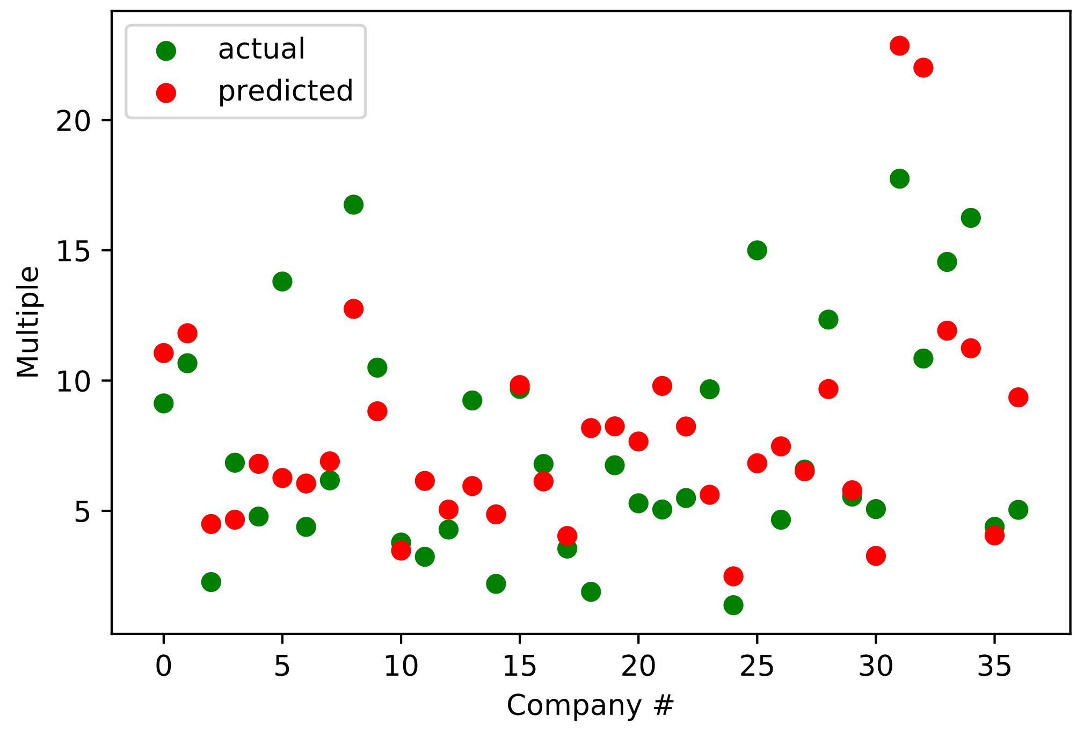
PROJECT TETRIS: Proposed Investment of up to USD40m into Databricks, an advanced big data processing company
Investment Committee Paper No: [ ]
Division: INVESTMENTS
Priority: HIGH
FOR APPROVAL
2. Linear Regression
A correlation test was first performed to determine the correlation between each independent variable and the EV/TTM Revenue multiple. A preliminary linear regression was then conducted to determine significant variables according to p-values (<0.05).
Model Coefficients
Model Features
Constant | (0.95)
Revenue Growth | 14.14
Gross Margin | 11.63
EBITDA Margin | (6.75)
S&M % of Revenue | (7.82)
Adjusted R Squared | 0.221 | Suggests that roughly 22% of the variability in EV/TTM can be explained by our variables.
Margin of Error | 4.461 | Potential margin of error in either direction from the predicted value (with a 95% confidence).
Mean Squared Error | 3.702 | On average, the margin of error between the predicted values and the actual values.
A
B
C
D
E
Due to a high degree of multicollinearity between EBITDA Margin and S&M % of Revenue, the coefficients cannot be considered individually, only as a whole.
Preliminary Results
Linear Regression against Test Population
TTM Revenue | USD66.7m
NTM Revenue | USD130.1m
NTM Revenue Growth Rate | 95.2%
Gross Margin | 67.1%
EBITDA Margin | (114.9%)
R&D % of Revenue | 57.7%
S&M % of Revenue | 98.2%
Profit Margin | (111.3%)
Predicted EV/NTM Revenue | = 22.5x
Model unreliable for higher multiples
F
G
H
I
+
x
+
x
+
x
+
x
A
B
F
C
G
D
H
E
I
Applying the linear regression model to Databricks, we attain a predicted EV/TTM Revenue multiple of 22.5x and an implied EV of USD1.5bn.
Source: Bloomberg

Slide 5
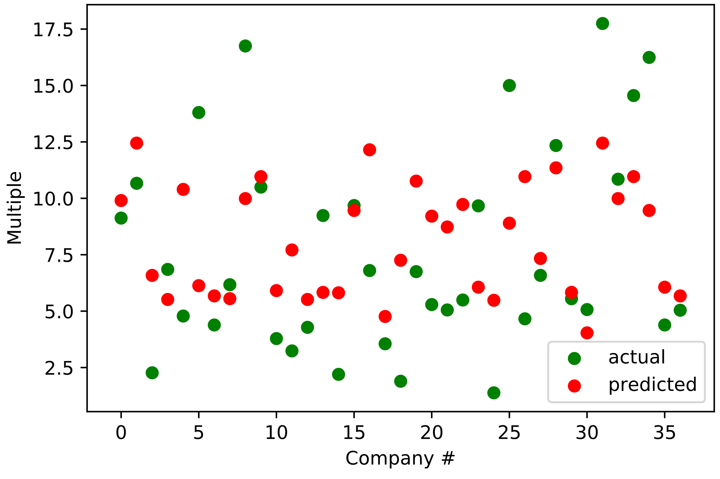
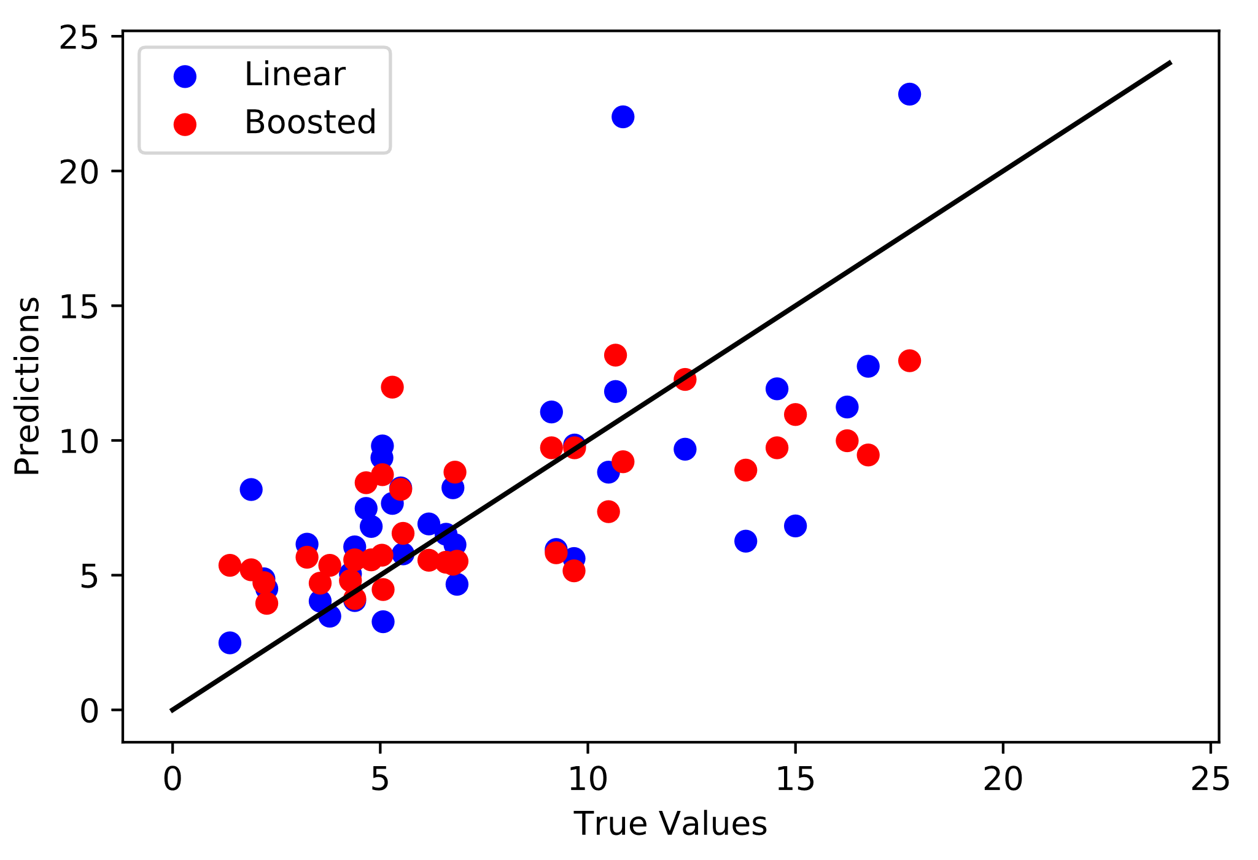
PROJECT TETRIS: Proposed Investment of up to USD40m into Databricks, an advanced big data processing company
Investment Committee Paper No: [ ]
Division: INVESTMENTS
Priority: HIGH
FOR APPROVAL
3. Adaptive Boost Regression
Adaptive Boost is a predictive regression method that uses machine learning principles to progressively train the data to improve its predictive capabilities. It does this through a concept known as “boosting”, where “weak learners” in a dataset are combined to form “strong learners”.
Model Training Concept
Model Features
Strong Learner / Predictor
Adjusted R Squared | 0.434 | Suggests that roughly 43% of the variability in EV/TTM can be explained by our variables.
Margin of Error | 3.804 | Potential margin of error in either direction from the predicted value (with a 95% confidence).
Mean Squared Error | 3.158 | On average, the margin of error between the predicted values and the actual values.
Weak Learner / Predictor
In adaptive boosting, several iterations of the model are generated. Each iteration applies a weighting to the inputs from the previous iteration. Inputs that perform well receive a lower weight and vice versa. Weightings affect how often the input will be selected in future training iterations. This way, the model trains on more “outlier” inputs as training goes on, creating a model that can better predict outliers.
Preliminary Results
Regression Model Results vs. Actual Values
Model conservative in predicting higher multiples
Model skews higher for low multiples
Source: Bloomberg

Slide 6
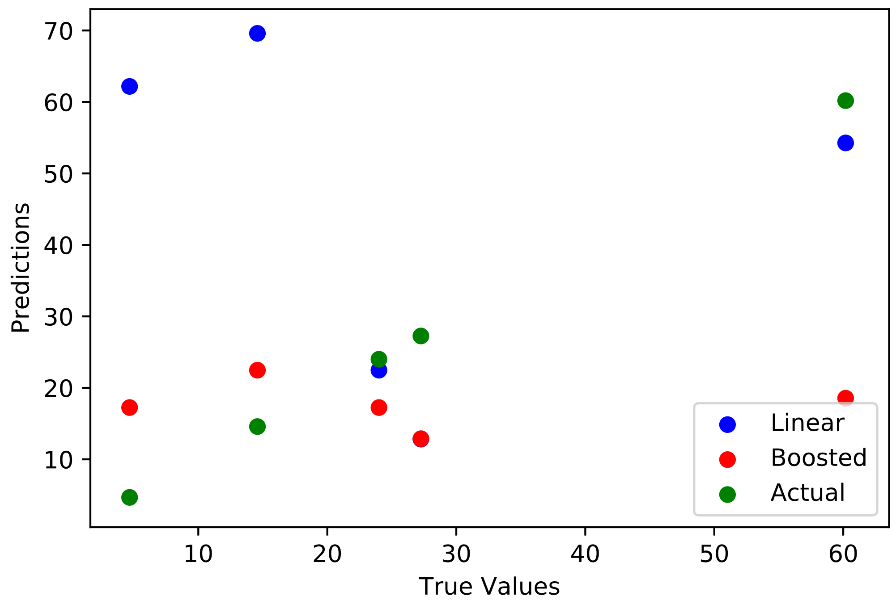
PROJECT TETRIS: Proposed Investment of up to USD40m into Databricks, an advanced big data processing company
Investment Committee Paper No: [ ]
Division: INVESTMENTS
Priority: HIGH
FOR APPROVAL
4. Application to Khazanah Prospective Companies
By applying the training model to several of Khazanah’s former prospective companies, a rough comparison of the effectiveness of the two models was created. In 3/5 scenarios, the linear regression model performed significantly better while in 2/5 scenarios, the boosted model performed
Examined Companies
Feature | Databricks | Velocloud | Crowdstrike | Mesosphere | Parallel Wireless
TTM Revenue | 66.7 | 61.0 | 115.6 | 10.8 | 24.0
NTM Revenue Growth Rate | 95.2% | 273% | 43.3% | 168.5% | 353%
Gross Margin | 67.1% | 28% | 54.7% | 73.0% | 82%
EBITDA Margin | (114.9%) | (369%) | (96.7%) | (325%) | (148%)
R&D % of Revenue | 57.7% | 131% | 47.2% | 50.6% | 12%
S&M % of Revenue | 98.2% | 110% | 90.1% | 37.5% | 9%
Profit Margin | (111.3%) | (381%) | (108.6%) | (325%) | (102%)
Data Selection Methodology
Regression Model Results vs. Actual Values
Most recently available actual data used when provided, may not be exactly TTM.
Projected growth rate from management was used when available, otherwise team’s projections were used.
Post-Money Valuation (EV) from PitchBook was used when available, otherwise team’s projections were used.
Most of the available transactions
Parallel Wireless
Mesosphere
Crowdstrike
Velocloud
Databricks
Source: Company Website and Provided Data

Slide 7
PROJECT TETRIS: Proposed Investment of up to USD40m into Databricks, an advanced big data processing company
Investment Committee Paper No: [ ]
Division: INVESTMENTS
Priority: HIGH
FOR APPROVAL
 | Risks | Potential Mitigation
Quality and Size of Dataset | The revenue growth rate retrieved from Bloomberg is based off of analyst projections that are not guaranteed to be accurate. A portion of the data retrieved was also incomplete (missing one or more of analyzed variables), and incomplete datasets were removed from the analysis, potentially skewing or biasing the companies analyzed. Additionally, many companies added cannot be considered direct competitors or comparison companies to Databricks, the overall pool should be carefully re-examined and refreshed for future analysis. Furthermore the data was all pulled at a specific point in time, making it difficult to evaluate the usefulness of the model as it was trained on a specific day of trading. | Additionally, many companies added cannot be considered direct competitors or comparison companies to Databricks, the overall pool should be carefully re-examined and refreshed for future analysis. Furthermore the data was all pulled at a specific point in time, making it difficult to evaluate the usefulness of the model as it was trained on a specific day of trading.
Difficulty Extrapolating | Despite the superior performance of the Adaptive Boosted model on the test sample of 30 companies, the linear regression model performed significantly better than the boosted model on 3/5 prospective companies. As demonstrated by the initial spread of results from the Adaptive Boosted model, the model tended to normalize all results within a consistent band, underestimating high multiples and overestimating lower multiples. This would make it very difficult for the boosted model to perform when applied to a set of private companies with highly inflated multiple valuations. | Consider utilizing a pool of strictly private company data. This could potentially be pulled from company S-1s prior to IPO. However, the tradeoff lies in the loss of any time-value, as each company’s IPO date and surrounding market conditions will be completely different. The difficulty with this method lies in giving up the potential value of the available d
Risk of Overfitting | Since the test set only contained 14 companies, it is difficult to determine whether the AdaBoost model is truly superior or if it was based on chance. Furthermore, the model is at risk of being inaccurate if the dataset is of poor quality (inherently biased or incomplete). | Additionally, many companies added cannot be considered direct competitors or comparison companies to Databricks, the overall pool should be carefully re-examined and refreshed for future analysis. Furthermore the data was all pulled at a specific point in time, making it difficult to evaluate the usefulness of the model as it was trained on a specific day of trading.
Potential Rationale | d

Slide 8
PROJECT TETRIS: Proposed Investment of up to USD40m into Databricks, an advanced big data processing company
Investment Committee Paper No: [ ]
Division: INVESTMENTS
Priority: HIGH
FOR APPROVAL

Slide 9
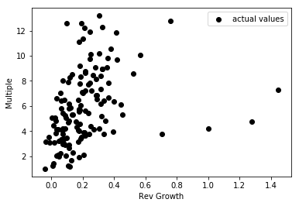
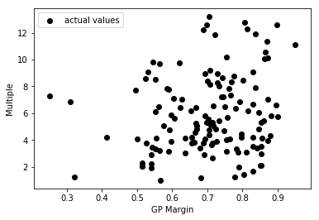
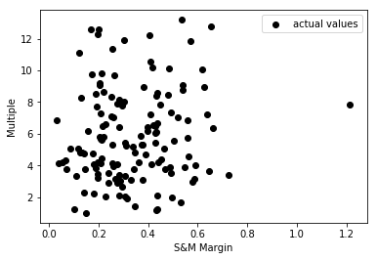
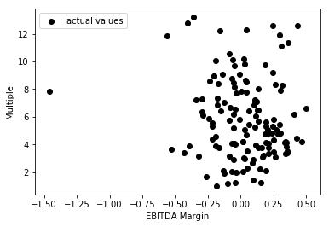
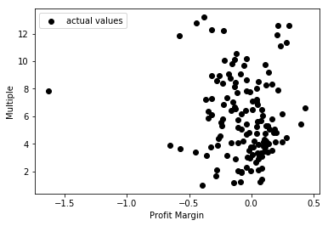
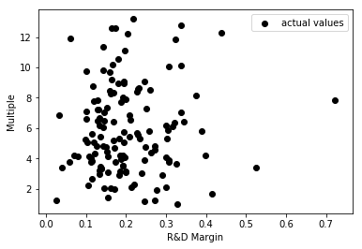
PROJECT TETRIS: Proposed Investment of up to USD40m into Databricks, an advanced big data processing company
Investment Committee Paper No: [ ]
Division: INVESTMENTS
Priority: HIGH
FOR APPROVAL
4. Single Variable Comparisons to Multiple
Revenue Growth vs. Multiple
GP Margin vs. Multiple
S&M Margin vs. Multiple
Revenue Growth | 0.579
EBITDA Margin | (0.253)
Profit Margin | (0.233)
R&D % of Revenue | 0.156
S&M % of Revenue | 0.133
Gross Margin | 0.04
Corr = 0.325
Corr = 0.176
Corr = 0.116
EBITDA Margin vs. Multiple
Profit Margin vs. Multiple
R&D Margin vs. Multiple
Corr = -0.110
Corr = -0.090
Corr = 0.063
Note: (1) Subsectors “Application Software” + “Data Processing” + “Systems Software”
Source: Company Website and Provided Data

